Slide 1
Disadvantages of Telework
Threatens managers’ control and authority
Makes face-to-face meetings impossible
Sensitive information less secure
Team meetings more difficult
Teleworkers less visible
Teleworkers “out of the loop”
Isolation of teleworkers
Teleworkers work longer hours for same pay
1-<number>

Slide 2
Temporary Work
Companies less committed to employees
Lay-offs not taboo as they once were
Companies hiring more temporary employees
  Saves money on benefits
  Makes it easier to downsize
Long-term employment for one firm less common
1-<number>

Slide 3
Monitoring
82% of companies monitor employees in some way
  Purpose: Identify inappropriate use of company resources
  Can also detect illegal activities
Other uses of monitoring
  Gauge productivity (10% of firms)
  Improve productivity
  Improve security
1-<number>

Slide 4
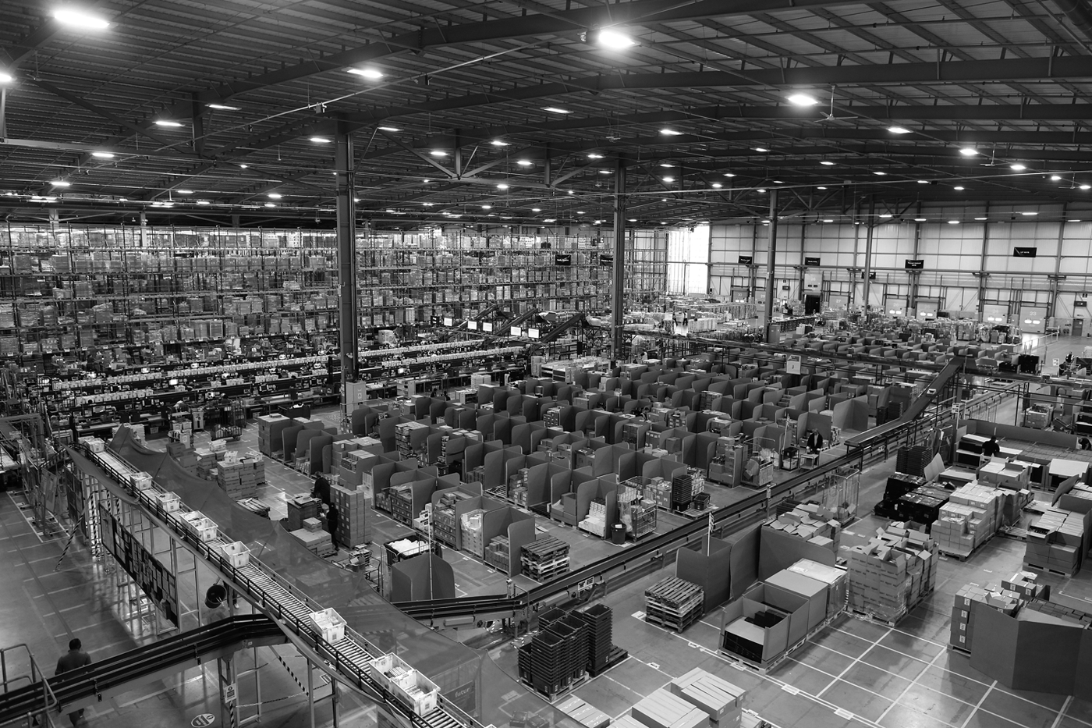
Computers Direct Movement of Workers in This Amazon Warehouse
1-<number>

Slide 5
Multinational Teams
Software development teams in India since 1980s
Advantages of multinational teams
  Company has people on duty more hours per day
  Cost savings
Disadvantage of multinational teams
  Poorer infrastructure in less developed countries
1-<number>

Slide 6
10.4 Globalization
1-<number>

Slide 7
Globalization Basics
Globalization: Process of creating a worldwide network of businesses and markets
Globalization causes a greater mobility of goods, services, and capital around the world
Globalization made possible through rapidly decreasing cost of information technology
1-<number>

Slide 8
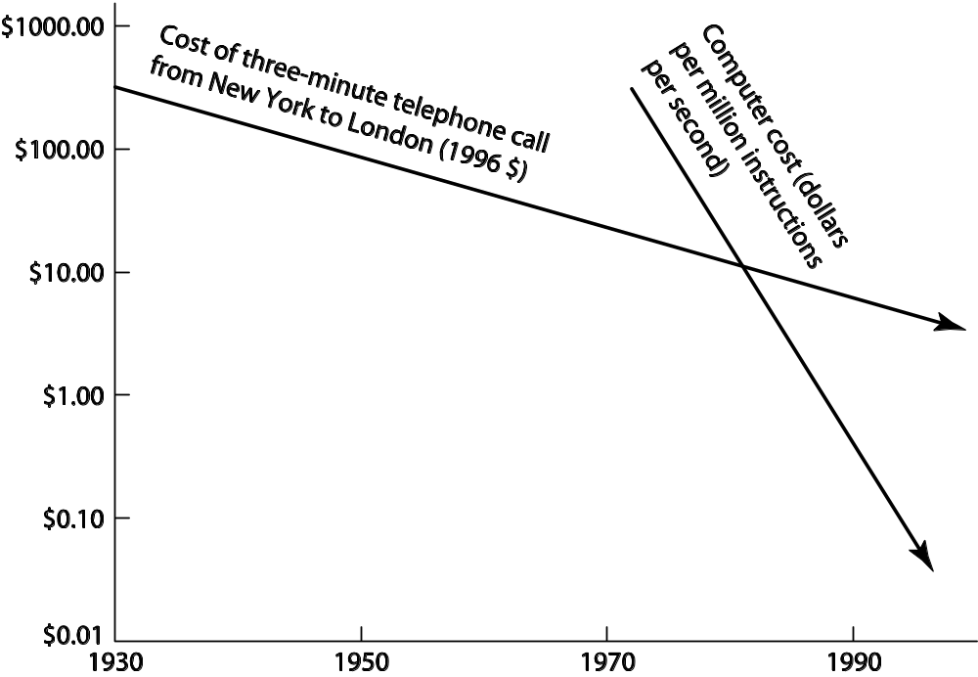
Declines in Computing & Communication Costs Spurred Globalization
1-<number>

Slide 9
Arguments for Globalization
Increases competition
People in poorer countries deserve jobs, too
It is a tried-and-true route for a poor country to become prosperous
Global jobs reduce unrest and increase stability
1-<number>

Slide 10
Arguments against Globalization
Makes the United States subordinate to the World Trade Organization
Forces American workers to compete with foreigners who do not get decent wages and benefits
Accelerates exodus of manufacturing and white-collar jobs from United States
Hurts workers in foreign countries
1-<number>

Slide 11
Dot-Com Bust Increases IT Sector Unemployment
Dot-com: Internet-related start-up company
Early 2000: stock prices of dot-coms fell sharply
Hundreds of dot-coms went out of business
Half a million high-tech jobs lost
1-<number>

Slide 12
Foreign Workers in the IT Industry
Visas allow foreigners to work inside U.S.
H-1B
  Right to work up in United States to six years
  Company must show no qualified Americans available
  Congress still authorizes 65,000 H-1B visas per year, plus 20,000 more for foreigners with advanced degrees
  Quota not filled in 2009 due to economic downturn
L-1
  Allows a company to transfer a worker from an overseas facility to the United States
  Workers do not need to be paid the prevailing wage
  In 2006 about 50,000 foreigners in U.S. under L-1 visa
1-<number>

Slide 13
Foreign Competition
China is world’s number one producer of computer hardware
IT outsourcing to India is growing rapidly
Number of college students in China increasing rapidly
ACM Collegiate Programming Contest provides evidence of global competition
1-<number>

Slide 14
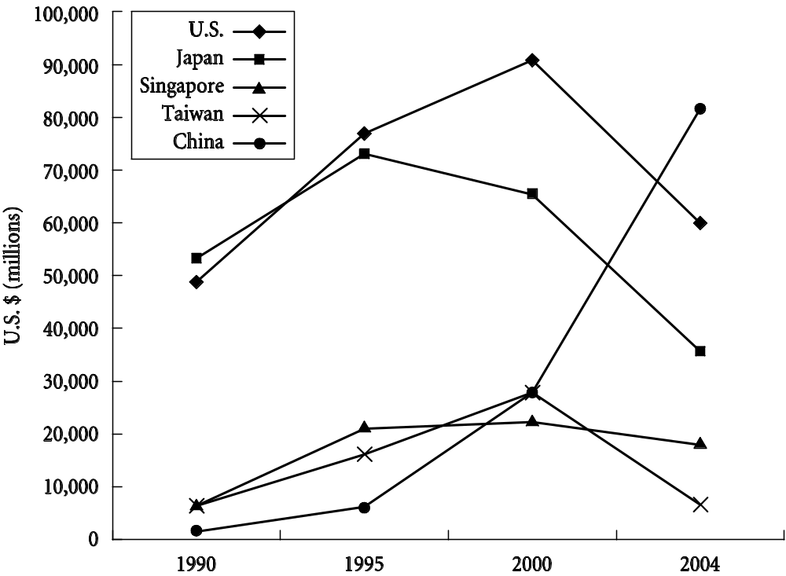
Growth of China’s Computer-Hardware Industry
1-<number>

Slide 15
10.5 The Digital Divide
1-<number>

Slide 16
Concept of the Digital Divide
Digital divide: Some people have access to modern information technology while others do not
Underlying assumption: people with access to telephones, computers, Internet have opportunities denied to those without access
Concept of digital divide became popular with emergence of World Wide Web
1-<number>

Slide 17
Evidence of the Digital Divide
Global divide
  Access higher in wealthy countries
  Access higher where IT infrastructure good
  Access higher where literacy higher
  Access higher in English-speaking countries
  Access higher where it is culturally valued
Social divide
  Access higher for young people
  Access higher for well-educated people
1-<number>

Slide 18
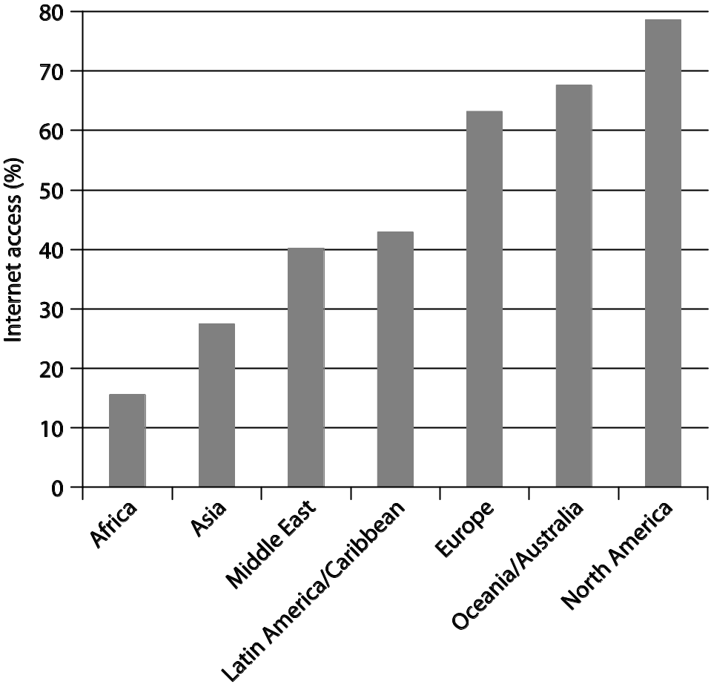
Percentage of People with Internet Access, by World Region
1-<number>

Slide 19
Models of Technological Diffusion
Technological diffusion: rate at which a new technology is assimilated
  Group A: highest socioeconomic status
  Group B: middle socioeconomic status
  Group C: lowest socioeconomic status
Normalization model
  Group A adopts first, then Group B, finally Group C
  Eventually A use = B use = C use
Stratification model
  Group A adopts first, then Group B, finally Group C
  A use > B use > C use forever
1-<number>

Slide 20
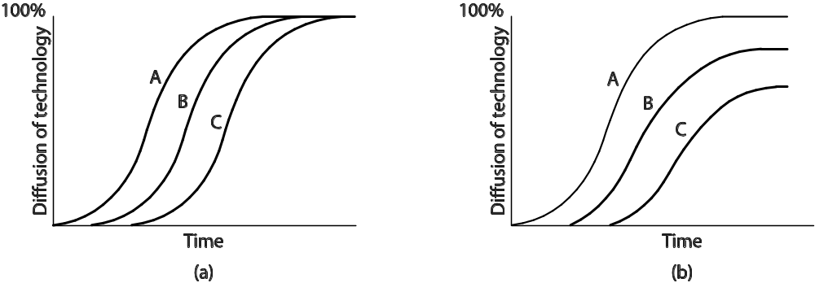
Two Models for Technological Diffusion
1-<number>

Slide 21
Critiques of the Digital Divide
DD talk suggests the difference between “haves” and “have nots” is simply about access
DD talk puts everyone in two categories, but reality is a continuum
DD implies lack of access leads to less advantaged social position, but maybe it is the other way around
Internet is not the pinnacle of information technology
1-<number>

